Slide 1

BSSE -Software Quality Engineering
Week-1 Lecture1
Semester 6- Fall 2020

Slide 2
Introduction to Software Quality Engineering
Ms. Zarsha Nazim

Slide 3
Purpose of the course
Expectations

Slide 4
Learning Outcomes
Lecture Overview
Course Introduction, Objectives and Contents
An Initial Definition of (Software) Quality
Standard Definitions of (Software) Quality
Quality Problems in Large Software
Turning Failure to Success: SQE
SQE for Meeting Quality Expectations
The SQE Process
Scope of Major SQE Activities

Slide 5
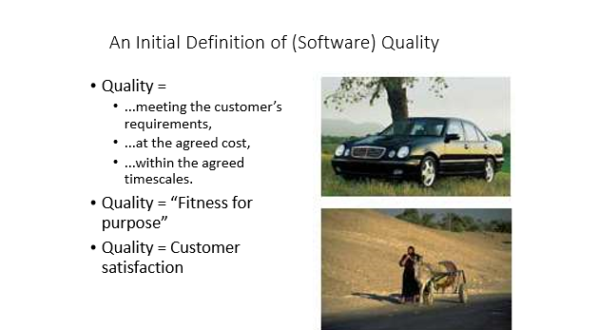

Slide 6
Standard Definitions of (Software) Quality
• IEEE Glossary: Degree to which a system, component, or process meets • (1)specified requirements, and •
(2)customer or user needs or expectations
• ISO 8402: The totality of features and characteristics of a product or service that bear on its ability to satisfy specified or implied needs

Slide 7
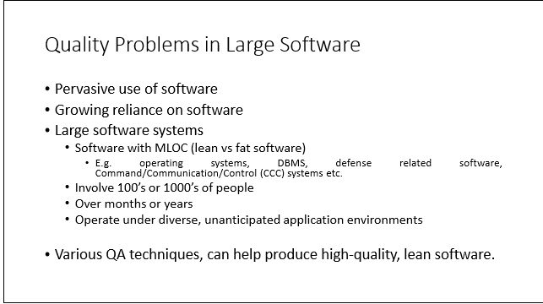
Quality Problems in Large Software

Slide 8
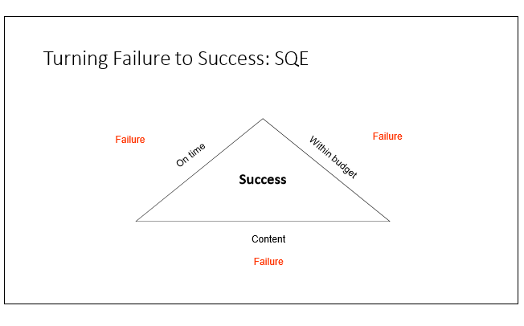

Slide 9
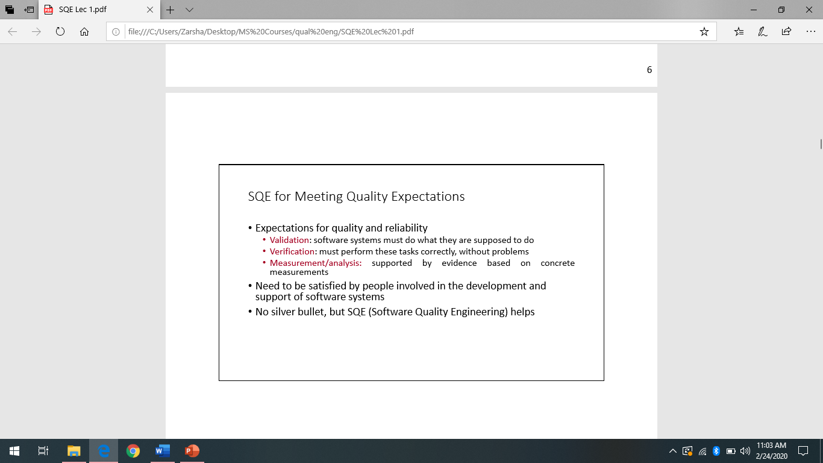

Slide 10
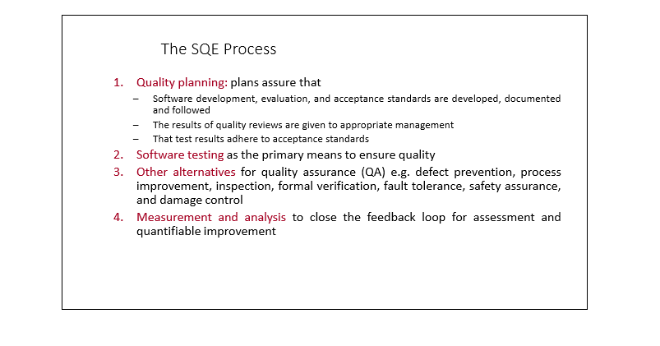

Slide 11
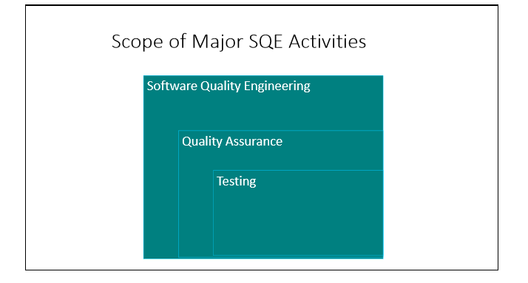

Slide 12
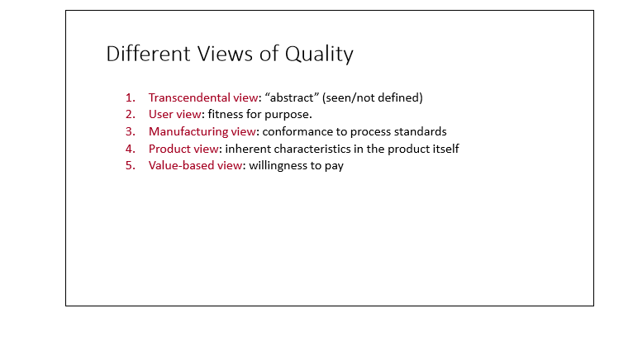

Slide 13
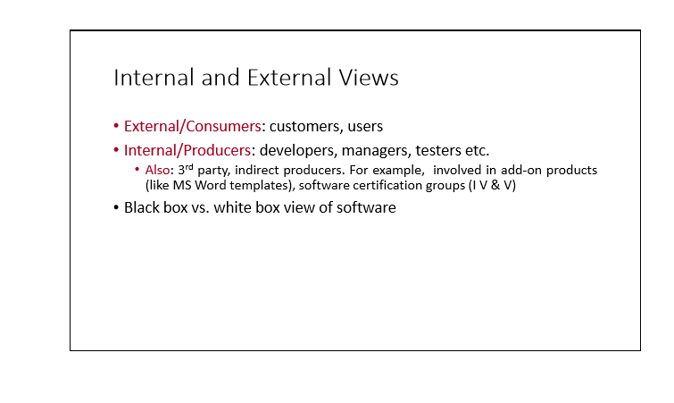

Slide 14
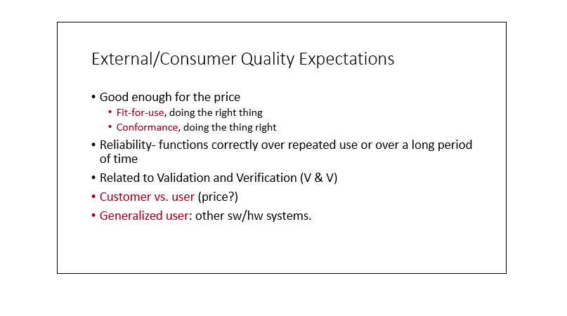

Slide 15
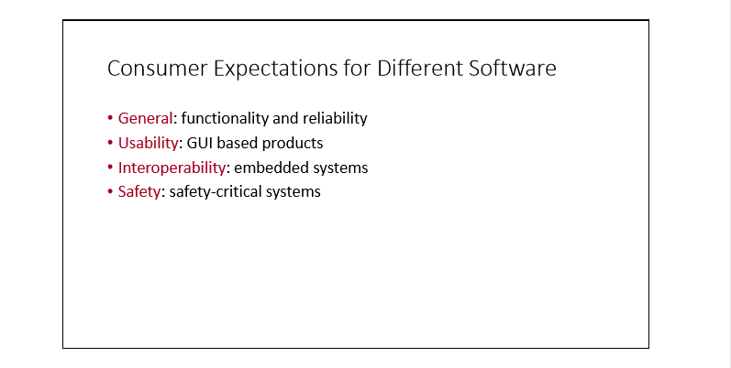

Slide 16
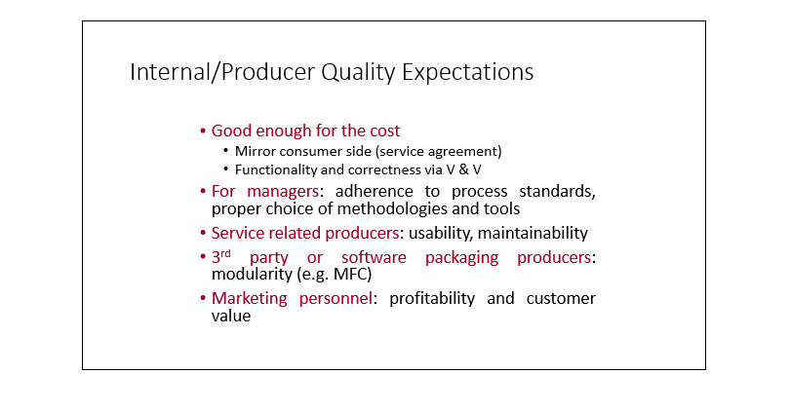

Slide 17
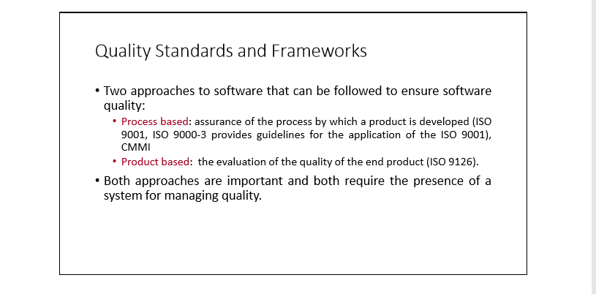

Slide 18
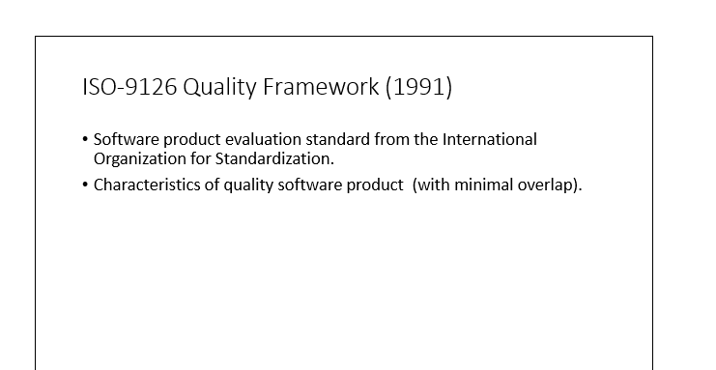

Slide 19
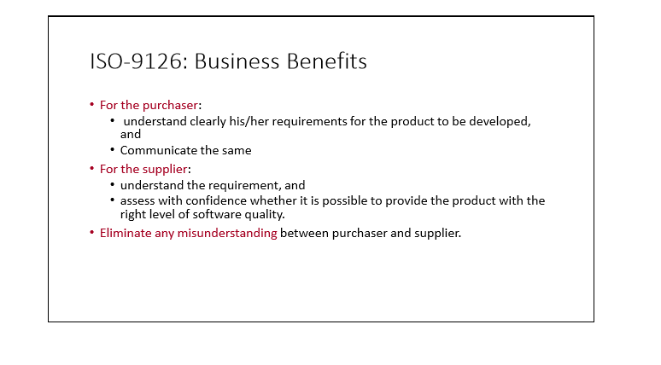

Slide 20
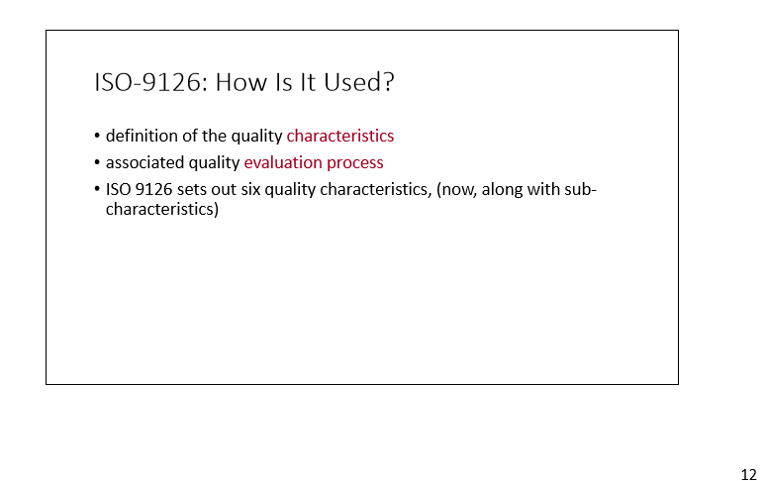

Slide 21
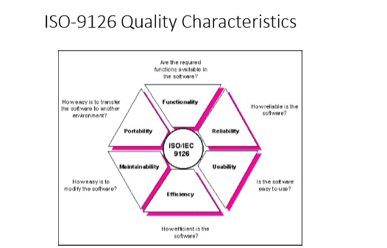

Slide 22
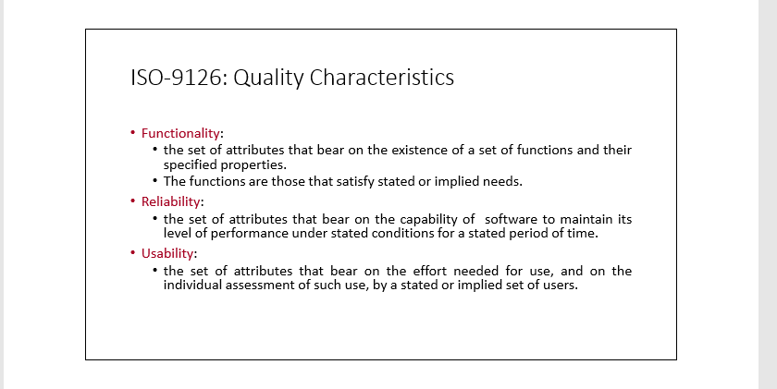

Slide 23
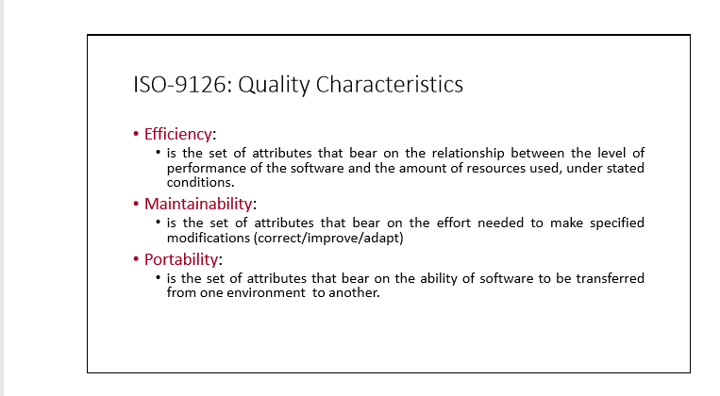

Slide 24
